Slide 1
Smart-Gas Pte Ltd
140 Paya Lebar Road #05-21, AZ Building, Singapore 409015
Tel : (65) 6848 1040 / Fax : (65) 6848 2173
IGEU 8899860 - General Identity & Weights
Tank Number | IGEU 8899860
Manufacturer | Unviersal
Date of Mfg | 19-Nov-2025
Lease | No
UN ISO Code | T11
Size | 20'
Tare Weight | 12,000 kg
Gross Weight | 4,850 kg
Net Weight | 4,200 kg
MGW | 10,000 kg
MPL | 12,346 kg

Slide 2
Smart-Gas Pte Ltd
140 Paya Lebar Road #05-21, AZ Building, Singapore 409015
Tel : (65) 6848 1040 / Fax : (65) 6848 2173
IGEU 8899860 - Technical Specifications
Capacity | 25,000 L
MAWP | 11 Bar
Working Pressure | 100 Bar
Design Temp | -196°C to 50°C
Vessel Material | Carbon Steel SA-516 Gr. 70
PV Code | GB150 / IMDF

Slide 3
Smart-Gas Pte Ltd
140 Paya Lebar Road #05-21, AZ Building, Singapore 409015
Tel : (65) 6848 1040 / Fax : (65) 6848 2173
IGEU 8899860 - Construction Details
Frame Type | normal
Cabinet | yes
Color | Safety Yellow
Pump Type | Yes
Remarks | Outlet valve requires inspection during next service. Fitted with pressure relief device P RD-456

Slide 4
Smart-Gas Pte Ltd
140 Paya Lebar Road #05-21, AZ Building, Singapore 409015
Tel : (65) 6848 1040 / Fax : (65) 6848 2173
IGEU 8899860 - Latest Inspection Summary
Report No | SG-T1-28112025-01
Inspection Date | 28-Nov-2025
Status | 1
Type | 1
Location | 3
Inspector | naveen@gmail.com
Safety Valve Brand | 2
Safety Valve Model | 1
Notes | All checks ok

Slide 5
Smart-Gas Pte Ltd
140 Paya Lebar Road #05-21, AZ Building, Singapore 409015
Tel : (65) 6848 1040 / Fax : (65) 6848 2173
IGEU 8899860 - Regulations
Regulation | Approval | IMO | Safety | Country
API Standard 650 | AP-2025-005 | IMO-T11 | EN 1445 | IND
API Standard 650 | AP-2025-005 | IMO-T11 | EN 1444 | IND

Slide 6
Smart-Gas Pte Ltd
140 Paya Lebar Road #05-21, AZ Building, Singapore 409015
Tel : (65) 6848 1040 / Fax : (65) 6848 2173
IGEU 8899860 - Approved Cargos
Cargo | Density | Parts | Notes
CT-Alpha-01 | 1.1kg/m^3 | valve | teflon
CT-Bravo-02 | 1.5kg/m^3 | pump valve 1 | Requires teflon

Slide 7
Smart-Gas Pte Ltd
140 Paya Lebar Road #05-21, AZ Building, Singapore 409015
Tel : (65) 6848 1040 / Fax : (65) 6848 2173
IGEU 8899860 - Certificates
Cert No | Agency | Insp Date | Next Due
123 | BV | 16-Nov-2025 | 09-Nov-2025
7 | LR | 23-Nov-2025 | 30-Nov-2025

Slide 8
Smart-Gas Pte Ltd
140 Paya Lebar Road #05-21, AZ Building, Singapore 409015
Tel : (65) 6848 1040 / Fax : (65) 6848 2173
IGEU 8899860 - Inspection Photos
Front_View
[Image Not Found]
Path: IGEU 8899860/originals/IGEU 8899860_front_view_6e63872818ab4d3d866cc7876ca4d0bd.jpeg
Rear_View
[Image Not Found]
Path: IGEU 8899860/originals/IGEU 8899860_rear_view_ae514a7babea4755bc88a3ff1e6c22ca.jpeg

Slide 9
Smart-Gas Pte Ltd
140 Paya Lebar Road #05-21, AZ Building, Singapore 409015
Tel : (65) 6848 1040 / Fax : (65) 6848 2173
IGEU 8899860 - Inspection Photos
Top_View
[Image Not Found]
Path: IGEU 8899860/originals/IGEU 8899860_top_view_c37d174eb6db48e5900f44bc568ae95b.jpeg
Undersideview01
[Image Not Found]
Path: IGEU 8899860/originals/IGEU 8899860_undersideview01_a5fd19806175493eb0efc5ca7c9df4d0.jpeg

Slide 10
Smart-Gas Pte Ltd
140 Paya Lebar Road #05-21, AZ Building, Singapore 409015
Tel : (65) 6848 1040 / Fax : (65) 6848 2173
IGEU 8899860 - Inspection Photos
Undersideview02
[Image Not Found]
Path: IGEU 8899860/originals/IGEU 8899860_undersideview02_869869e1a14945278cb94ab6a9c4385c.jpeg
Front_Lh_View
[Image Not Found]
Path: IGEU 8899860/originals/IGEU 8899860_front_lh_view_38fdeb19b2274f8c805f8b2694ff0cc3.jpeg

Slide 11
Smart-Gas Pte Ltd
140 Paya Lebar Road #05-21, AZ Building, Singapore 409015
Tel : (65) 6848 1040 / Fax : (65) 6848 2173
IGEU 8899860 - Inspection Photos
Rear_Lh_View
[Image Not Found]
Path: IGEU 8899860/originals/IGEU 8899860_rear_lh_view_23285877c414469d96565565bb50b35b.jpeg
Front_Rh_View
[Image Not Found]
Path: IGEU 8899860/originals/IGEU 8899860_front_rh_view_e70c768ec91547529aa67fbb263694cb.jpeg

Slide 12
Smart-Gas Pte Ltd
140 Paya Lebar Road #05-21, AZ Building, Singapore 409015
Tel : (65) 6848 1040 / Fax : (65) 6848 2173
IGEU 8899860 - Inspection Photos
Rear_Rh_View
[Image Not Found]
Path: IGEU 8899860/originals/IGEU 8899860_rear_rh_view_8cf3ef8330ad4f1197fd938ff1652987.jpeg
Lh_Side_View
[Image Not Found]
Path: IGEU 8899860/originals/IGEU 8899860_lh_side_view_24afdbfb3362438cb9d49d690b6dd9a4.jpeg

Slide 13
Smart-Gas Pte Ltd
140 Paya Lebar Road #05-21, AZ Building, Singapore 409015
Tel : (65) 6848 1040 / Fax : (65) 6848 2173
IGEU 8899860 - Inspection Photos
Rh_Side_View
[Image Not Found]
Path: IGEU 8899860/originals/IGEU 8899860_rh_side_view_14f870e853ee447bac6a0d0e618ac927.jpeg
Valves_Section_View
[Image Not Found]
Path: IGEU 8899860/originals/IGEU 8899860_valves_section_view_860f2cbefb3f4225a6aadbed000f3ce3.jpeg

Slide 14
Smart-Gas Pte Ltd
140 Paya Lebar Road #05-21, AZ Building, Singapore 409015
Tel : (65) 6848 1040 / Fax : (65) 6848 2173
IGEU 8899860 - Inspection Photos
Safety_Valve
[Image Not Found]
Path: IGEU 8899860/originals/IGEU 8899860_safety_valve_914567b3ace649618a3dfe43f3359e30.jpeg
Level___Pressure_Gauge
[Image Not Found]
Path: IGEU 8899860/originals/IGEU 8899860_level___pressure_gauge_833d3264152f4562a3e700d28c99a2df.jpeg

Slide 15
Smart-Gas Pte Ltd
140 Paya Lebar Road #05-21, AZ Building, Singapore 409015
Tel : (65) 6848 1040 / Fax : (65) 6848 2173
IGEU 8899860 - Inspection Photos
Vacuum_Reading
[Image Not Found]
Path: IGEU 8899860/originals/IGEU 8899860_vacuum_reading_cd6b54b2bbb441d1a96a73bcec5cd89f.jpeg

Slide 16

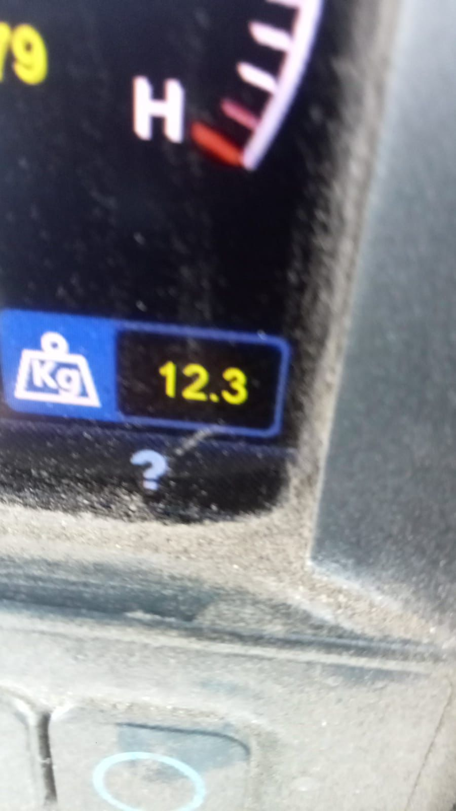
Smart-Gas Pte Ltd
140 Paya Lebar Road #05-21, AZ Building, Singapore 409015
Tel : (65) 6848 1040 / Fax : (65) 6848 2173
IGEU 8899860 - Certificate Documents
Cert: 123
Cert: 7

Slide 17
Smart-Gas Pte Ltd
140 Paya Lebar Road #05-21, AZ Building, Singapore 409015
Tel : (65) 6848 1040 / Fax : (65) 6848 2173
IGEU 8899860 - Technical Drawings
Drawing: PFD (Process Flow Diagram)
Drawing: P&ID (Piping & Instrumentation Diagram)

Slide 18
Smart-Gas Pte Ltd
140 Paya Lebar Road #05-21, AZ Building, Singapore 409015
Tel : (65) 6848 1040 / Fax : (65) 6848 2173
IGEU 8899860 - Valve Test Documents
Report: 17-Nov-2025
[PDF/Doc: IGEU 8899860_valve_reports.webp]
Report: 30-Nov-2025

